Slide 1
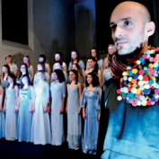




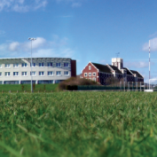

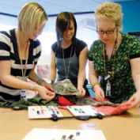


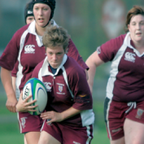

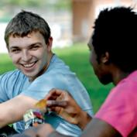
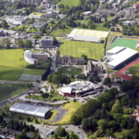
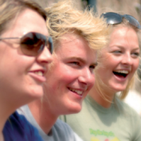



Have I been
doing Behavioural OR for
the Last 20 Years?
Stewart Robinson
Professor of Management Science
Associate Dean Research
School of Business and Economics

Slide 2
Outline
To develop a better understanding of behavioural OR.
My research
Examples of modelling behaviour
Examples of understanding behaviour with models
Some key elements of BOR

Slide 3
My Research
Simulation practice
Simulation output analysis
Simulation conceptual modelling
Modelling human decision-making and interaction
The quality of operational research interventions
Agent-based simulation
Facilitated modelling with simulation
Comparison of DES and SD
Verification and validation of simulation models

Slide 4
Modelling Behaviour Part I: 1995
A Lorry Loading Bay Problem

Slide 5
Modelling Behaviour Part I: 1995
A Lorry Loading Bay Problem:
  Decision tree derived from example cases using a simulation model
Notes:
Idea extended to Ford Bridgend maintenance supervisors

Slide 6
Modelling Behaviour Part II: Knowledge Based Improvement
Investigation of the
operations system
Stage 1
Understanding the process
and the decision-
making required
Generate decision-
making scenarios
VIS model
Elicit
knowledge
Predict performance of
decision-making strategies
Stage 4
Stage 2
Decisions taken
under scenarios
(data sets held for
each decision-maker)
Data
sets
Provide input to the
VIS in place of
the decision-makers
Stage 3
Stage 5
Trains
AI model
Seek improvements
Represent the decision-making
strategy of each decision-maker

Slide 7
Modelling Behaviour Part II: Knowledge Based Improvement
Notes:
Looked at effect of visualisation on effectiveness (fidelity) of KBI
e.g. game console (F1 driving) problem

Slide 8
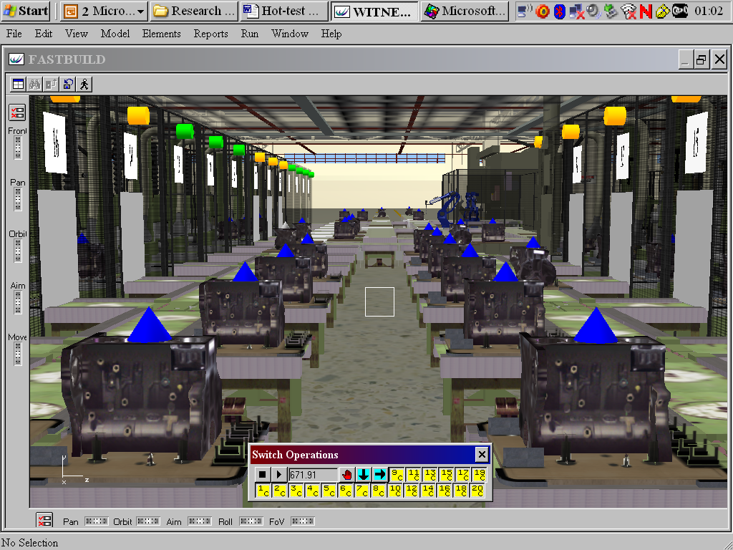
Modelling Behaviour Part II: Knowledge Based Improvement

Slide 9
Modelling Behaviour Part II: Knowledge Based Improvement

Slide 10
Modelling Behaviour Part III: Agent Based Modelling
Axelrod Culture Model: Diffusion of Ideas
 | 1 | 2 | 3 | 4 | 5 | 6 | 7 | 8 | 9 | 10
1 | 1_CDD | 2_CDD | 3_CDD | 4_CDD | 5_EBA | 6_CDD | 7_CDD | 8_CDD | 9_CDD | 10_CDD
2 | 11_CDD | 12_CDD | 13_CDD | 14_CDD | 15_EBA | 16_CDD | 17_CDD | 18_CDD | 19_FEE | 20_CDD
3 | 21_CDD | 22_CDD | 23_CDD | 24_EBA | 25_EBA | 26_CDD | 27_CDD | 28_CDD | 29_FEE | 30_CDD
4 | 31_CDD | 32_CDD | 33_CDD | 34_CDD | 35_EBA | 36_AFC | 37_AFC | 38_CDD | 39_FEE | 40_FEE
5 | 41_CDD | 42_CDD | 43_CDD | 44_CDD | 45_CDD | 46_CDD | 47_AFC | 48_AFC | 49_FEE | 50_FEE
6 | 51_CDD | 52_CDD | 53_CDD | 54_CDD | 55_CDD | 56_CDD | 57_AFC | 58_AFC | 59_FEE | 60_CDD
7 | 61_CDD | 62_CDD | 63_CDD | 64_CDD | 65_CDD | 66_CDD | 67_CDD | 68_AFC | 69_CDD | 70_CDD
8 | 71_CDD | 72_CDD | 73_CDD | 74_CDD | 75_CDD | 76_CDD | 77_CDD | 78_CDD | 79_CDD | 80_CDD
9 | 81_CDD | 82_CDD | 83_CDD | 84_CDD | 85_CDD | 86_CDD | 87_CDD | 88_CDD | 89_CDD | 90_CDD
10 | 91_CDD | 92_CDD | 93_CDD | 94_CDD | 95_CDD | 96_CDD | 97_CDD | 98_CDD | 99_CDD | 100_CDD
Notes:
Simple diffusion model: Susceptible, Infected, Recovered (SIR)
Describe model:
At each tick
Randomly choose an agent
Randomly chooses a neighbour (Von-Neumann neighbourhood of 4)
If one feature the same, 50% chance of changing another feature
Run with 6 and 12 traits
Results: number of regions, largest region (graph and numeric results)
Analogue of diffusion of ideas in an organisation
Modelling energisers and de-energisers.

Slide 11





Modelling Behaviour Part III: Agent Based Modelling
Agent Based Simulation of Supply Chains
Market demand
w
D
Supplier
Retailer
q
Min{q,D}
w(q)
p
Material
Funds
Information
Notes:
w – wholesale price
q – order quantity
D – market demand
p – retail price

Slide 12
Modelling Behaviour Part III: Agent Based Modelling
Suppliers
Retailers
Efficiency scores
F₁ F₂ | RET₁ | RET₂ | RET₃ | RET₄ | RET_{OPT}
SUP₁ | 0.150 (0.001) | 0.527 (0.006) | 0.397 (0.003) | 0.375 (0.003) | 0.320 (0.001)
SUP₂ | 0.434 (0.002) | 0.778 (0.008) | 0.636 (0.005) | 0.461 (0.005) | 0.644 (0.005)
SUP₃ | 0.708 (0.005) | 0.968 (0.012) | 0.851 (0.009) | 0.585 (0.008) | 0.849 (0.008)
SUP_{OPT} | 0.550 (0.003) | 0.878 (0.010) | 0.734 (0.007) | 0.507 (0.006) | 0.741 (0.006)
Notes:
Students play as retailers and suppliers
Regression equation:
w – wholesale price
q – order quantity
P – profit
d - demand

Slide 13
Behaviour with Models Part I: Model Building

Slide 14
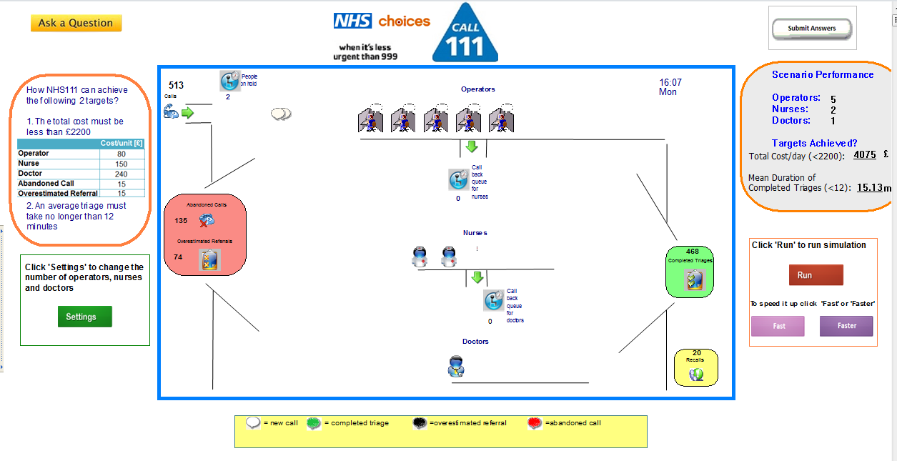
Behaviour with Models Part II: Model Using

Slide 15



Behaviour with Models Part III: Managers, Decision-Making and Models

Slide 16
Have I been doing Behavioural OR for the Last 20 Years?
Modelling Behaviour
Eliciting and modelling human behaviour
Agent-based modelling
Behaviour with Models
Understanding how decisions are made based on models
Understanding model building
Understanding model use

